Slide 1
Making a strong application to Oxford and Cambridge
Sebastian Baker
Head of A Level
Bellerbys College

Slide 2
I have a student who might be Oxbridge material
Do they have what it takes?

Slide 3
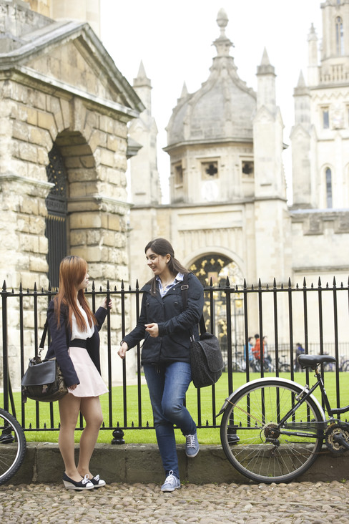
Oxbridge Potential
If you have students who look like they might have what it takes to win a place at Oxford or Cambridge, you need to ensure they do two things:
  Choose a college that understands the extra guidance they will need in order to submit a successful application
    Being smart and making a speculative application isn’t enough
  Choose a college that has a proper Oxbridge structure and specialist resources in place to give appropriate support

Slide 4

Students need to know why they want to do this
Applying to Oxbridge requires a huge amount of extra work
If a student doesn’t have a clear idea of why they want to attend an Oxbridge college, they will struggle
At Bellerbys, we interview all students who are interested in Oxford or Cambridge. And the first two questions that we ask are always:
  Why do you want to study a particular degree?
  Why do you want to study that subject at Oxford or Cambridge?
The answers need to be impressive, but…
Unfortunately I often get:
  “Because my father is also a lawyer”
  “Because I want to get a good job”
  “Because of the ranking and reputation”
  “Because its been my dream since I was young”

Slide 5

Applying to Oxbridge - The Process
Choose their degree area
  This must be done early, because of step 2
Do a very significant amount of further reading in your chosen subject area, complete online courses and enter competitions
Prepare their UCAS application and in particular, your personal statement
  Oxbridge application deadline is October 15th
Prepare to sit additional Thinking Skills Assessments depending on their chosen subject
  These usually take place in first week of November

Slide 6

Applying to Oxbridge - The Process – cont’d
If all the above has gone well, they may get called to interview:
  Typically in first 2 weeks of December
  On average interviewees have a 1 in 5 chance once they are called to interview (although this depends a lot on the degree)
Expect to hear back from Oxford or Cambridge in second week of January
Finally, if the student receives an offer from Oxford or Cambridge, they must then ensure they meet the grade conditions of that offer on A Level results day.

Slide 7

Choosing your degree – Should you play the game?
A student needs a very clear idea what subject they want from early stage
In some cases a slight shift in degree choice can make a big difference in increasing their chance of success. For example:
  Student A wants Economics at Oxford. The success rate for this subject is 7%
  They consider Maths at Oxford instead because there is an 18% success rate
It all depends on how important a place at Oxford or Cambridge is
  Some students are prepared to do anything to win a place there, including changing their degree

Slide 8

Further Reading
This ideally should have started even before a student starts their A Levels
It is important because the main thing being considered by admissions tutors at Oxbridge is:
  how interested in the subject is this student?
Easy to say how interested they are – much harder to show it.
A typical Oxbridge student combines the following:
    They find A Levels relatively easy
    They are intellectually very curious
It is point 2 that drives them to do the further reading
Point 1 means they have more time to do that reading

Slide 9
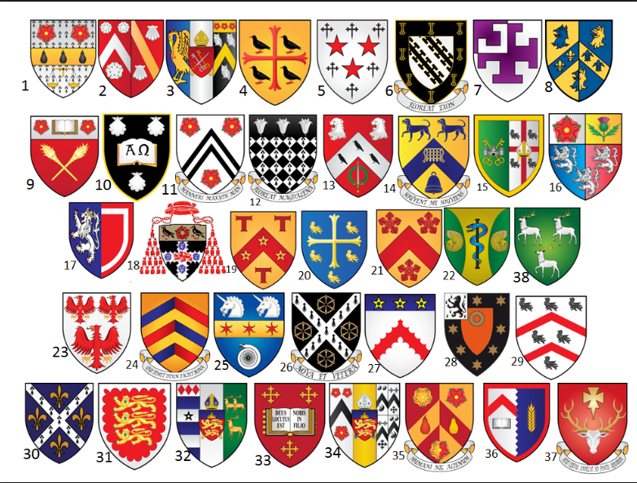
Which College?
Oxbridge operate a collegiate system
    38 in Oxford
    29 in Cambridge
An open application is possible, but choosing the specific college may have advantages
Generally, best to avoid the big, ultra traditional ones – e.g. Trinity College
If applicable, do consider newer colleges, colleges for mature students, etc.
We use specialist software to help students narrow down the choice

Slide 12

Personal Statement
The Personal Statement needs to be ready by 15th October and first drafts should be written in summer before.
Similar advice we give to all students:
  Explain reasons for wanting to study the subject at university
  Demonstrate enthusiasm for chosen course
  Express any particular interests within their field
  Show how they have has pursued their interest in the subject beyond the classroom.
Main differences would be:
  The academic content needs to be stepped up
  If a typical Personal Statement has a 60% academic content, 40% extra-curricular content, then an Oxbridge Personal Statement should have 80/20 split in favour of academics

Slide 13

Entrance Tests
These have been used by Oxford for some time
Increasingly used by Cambridge
  These exams are a way for universities to filter applications and thin down number of applications.
Examples of entrance exams:
  LNAT for Law
  MAT for Maths
  PAT for Physics
  HAT for History
  TSA for Economics or PPE
These exams are Hard!
The secret is practice and to have a knowledgeable teacher who can answer questions you may have

Slide 14
Personal Statement Examples
Student A - Physics
Student B - Engineering
My passion for Physics started strangely and suddenly the moment I read the first "Mr Tompkins" book. It was amazing for me to see how ridiculously high speeds can make time tick slower, make people look slimmer and how space-time can be curved. I was particularly amazed by the equations explaining time dilation for things moving close to the speed of light. This interest led me to study Einstein's "Special Relativity" and Dr Susskind's online lectures where I was able to understand more of the Maths involved, such as the Lorentz
transformations.
I started studying more Physics and got into the most prestigious high school in Vietnam to study the subject; there I covered three years of work in one year with the intention of competing in the National Physics Olympiad. Even though I did not have the chance to participate as I started studying in England, I will compete in the BPO this year. Studying in the UK has also exposed me to many new Physics experiments, which I have enjoyed doing (especially ones studying wave-particle duality), and I have also been encouraged to read a number of Physics books. "In search of Schrödinger's Cat" is one of my favourites as I enjoyed being challenged by new and bizarre ideas. The idea that attracted me the most was the Feynman Diagram and further research led me to read "QED" and The Feynman Lectures on Physics, which I usually read in my free time together with the New Scientist. Another area of Physics that fascinates me is Cosmology, so recently I undertook a MOOC course named "Greatest unsolved mysteries of the Universe", and found out why the Big Bang theory is favoured over others. Inspired by this I read "Big Bang" by S. Singh, where I learned more about the arguments between Steady State Theory and Big Bang Theory.
Nowadays, there are a lot of possibilities to earn money, but all of them require one thing, the ability to think. I chose to work as an engineer because it is interesting to understand how mechanical systems work and to reconstitute different structures that are in my head in whatever shapes I want; that is of course if they conform to the laws of physics. An example of beauty in engineering is the Sydney Opera House, the most famous sight in Australia. The shape of the building is quite complicated and it is covered in tiles. The shape and strength of the tiles are different for different parts of the building, therefore it is a complex structural problem to solve.
I chose to study and work in Engineering because I believe engineering is always required in our modern world; humankind cannot survive without technology. In particular, the introduction to the manufacturing industries of robotics has been transformative, and it is difficult to conceive of our contemporary world without robots. The robots can do the repetitive tasks leaving engineers to create new structures. In addition, my father and grandfathers were engineers, and they introduced me to all the delights of engineering. I visited my father’s civil engineering company, where I learned to design an office building. To help with my understanding of engineering and my communication skills, I worked over the summer in an engineering company. This involved the installation of air conditioning. My colleagues helped me a lot in understanding the internal systems of air conditioning, how it works and which wires connect to the power supply.

Slide 15
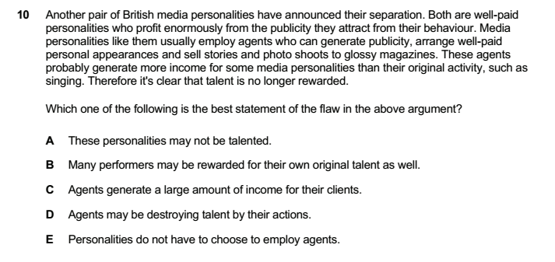
Examples

Slide 16
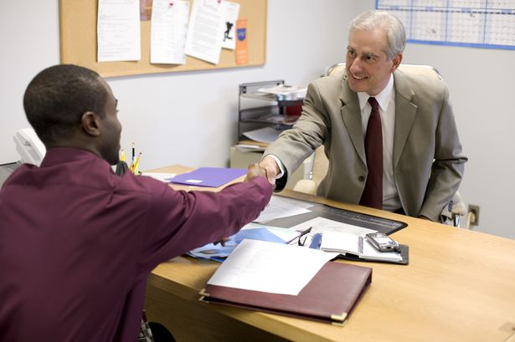
The Interview
This is often the hurdle where international students can fall. They:
  Struggle to think laterally and certain questions throw them
  Get very nervous and do not present themselves well
  Haven’t read enough and this is exposed at interview
  Prefer to adopt a quiet, listening approach – rather than engage in a dialogue with the interviewer
Perhaps the single best piece of advice is to treat the interview as though it is your very first lesson with that tutor.
The tutor will be asking themselves ‘Do I want to teach this person next year?’
So be someone who will make them answer Yes!
  Be intellectually curious and genuinely interested
  Enjoy being challenged and having to think again about your views and opinions
  Listen carefully to what the tutor says, but also be prepared to articulate your own view - aim to make the interview an academic conversation

Slide 17
Examples of Interview Questions
I’m having trouble with the meaning of 3 words: Lie, Deceive, Mislead. They seem to mean something similar, but not exactly the same. Help me sort them out from each other. (Law)
Should the UK continue to give aid to countries that have international space programmes e.g. India? (PPE)
How would you calculate the return on investment of Christopher Columbus’ voyages? (Economics)
There are 30 people in one room. What is the probability that exactly 2 of them have the same birthday? (Maths)
Why did the Titanic initially float? Why did it then split in two when it began to sink? (Physics)

Slide 18

Managing Expectations
Ambitious, intelligent students should definitely be encouraged to apply for Oxbridge
At the same time it is important to manage expectations and ensure we are being realistic
If a student focuses entirely on the extra work they need for Oxbridge they can sometimes fall behind in their actual A Levels
Sometimes it is better to focus on universities like LSE, UCL, Warwick, Bath, Durham, etc.
  All fantastic universities, but without the same academic gauntlet to run

Slide 19

Oxbridge Potential
If you do have students who seem to have Oxbridge potential, ensure they go to a college which:
  understands the extra guidance these students need, and
  has a proper structure and resources in place to give appropriate support

Slide 20

Questions?

